Slide 1
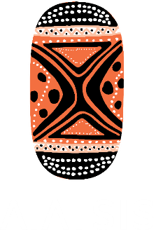
Returning native title materials -
30 years in the too hard basket
Dr Lisa Strelein and Dr Christiane Keller

Slide 2
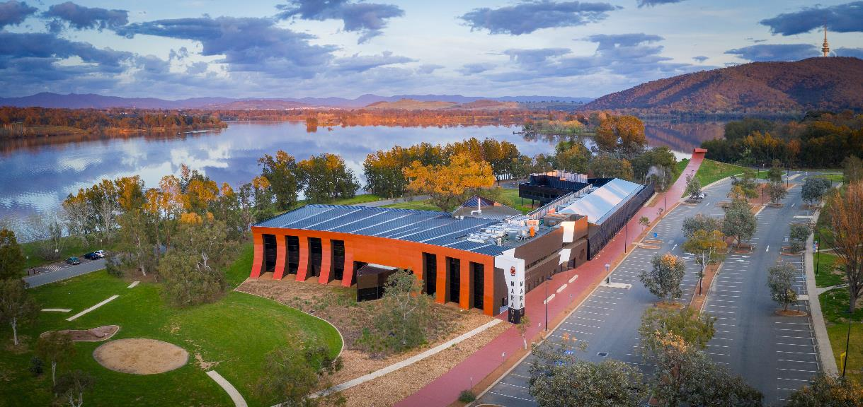
Acknowledgment of country

Slide 3
In today's presentation
What we understand as native title materials
AIATSIS’ work with native title materials
Returning native title materials project / case studies
Challenges
RNTM conclusions
RNTM publications and outlook

Slide 4
Requirements for a native title application
identification of the group claiming the area
evidence of descent from the group holding native title in the area at the time of sovereignty
existence of a system of traditional laws and customs and how these connect the people with the lands and waters claimed
establishment of the nature of the rights and interests claimed and evidence that these rights derive from the traditional laws and customs
Notes:
One of the most important aspects of the native title process involves tracing descent from the traditional owners of the land who could be identified at the time of sovereignty and proof of ongoing relationship to country. These requirements have resulted in the collection of vast and varied amounts of historical, ethnographic and cultural material which we call native title materials in this presentation.

Slide 5
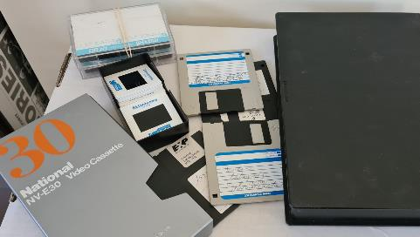
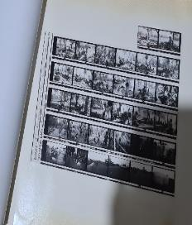
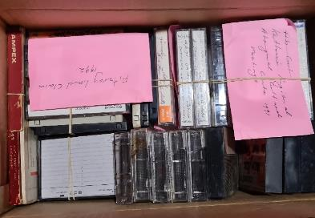
Native title materials include:
anthropological, linguistic, historical, archaeological and legal research documents
field notes
photographs
audio-visual recordings
drafts of genealogies
maps
digital files
Notes:
The array of native title materials is broad and many of them are endangered to become indecipherable or obsolete.
You may have heard of Deadline 2025, which is the date UNESCO established when materials stored on magnetic tape carries will no longer be playable due to deterioration of the tapes themselves and because the technology to playback such materials may no longer be available. There is an urgent need to digitise vulnerable materials before they are irretrievably lost.

Slide 6
AIATSIS research into native title materials
The future of connection materials (2005-2009) Grace Koch
Managing information in native title (MINT, 2013-2015) Pamela McGrath, Ludger Dinkler & Alexandra Andriolo
Returning native title materials (RNTM, 2018-2021) Stacey Little, Christiane Keller & Kieren Murray
Notes:
The origins of a number of projects focussing on native title materials started with Grace Koch, who was the Native Title Research and Access Officer from 2004-14. In providing NT materials to NTRBs it became apparent that the storage management and future of NT materials, especially that contained in connection reports was an emerging area of concern. In 2005 she instigated The future of connection materials project where she conducted case studies with KLC and NSW Native Title Services and met with representatives from 13 NTRBs in Canberra to discuss database needs and collection management practices with a final report published in 2008.
Grace convened on a regular basis with NTRBs during Native Title Conferences to talk about these issues. The amalgamation of several QLD NTRBS to QSNTS provided another opportunity for a case study on collection management needs. A further study was done in 2009 with Yamatji Marlpa Native Title Services and the report was finalised in March, 2010.
Grace’s interest then shifted toward the role of song and women’s evidence in land claim and native title proceedings culminating in the report We have the song, so we have the land: Song and ceremony as proof of ownership in Aboriginal and Torres Strait Islander land claims 2013.
In 2014 the new Native Title Access Officer Alexandra Andriolo and AIATSIS Research Fellow Dr Pamela McGrath embarked on the Managing native title information (MINT) project (2014-16) surveying NTRBs and PBCs about their information management practices, the size, scope and vulnerabilities of their holdings. This was followed by a two-day national workshop in Canberra on the use and security native title materials resulting in the published report in a 2015.
This then morphed into the Retuning native title materials (RNTM) project where the research focus was clearly trained on the return of materials to PBCs.

Slide 7
RNTM project
Survey of NTRB/SPs
Three case studies
The returns process: Yamatji Marlpa Aboriginal Corporation (YMAC) and Robe River Kuruma Aboriginal (RRKAC)
A digital approach: Esperance Tjaltjraak Native Title Aboriginal Corporation (ETNTAC)
Aboriginal land rights in the Northern Territory: Documenting and preserving the records and memories
Notes:
We started the project with a survey of NTRBs and then conducted 3 case studies. We had more case studies lined up but they did not come to fruition because in some cases the return proceedings were delayed and then Covid hit and made community visits impossible.

Slide 8
2019 survey of NTRB/SPs
returns were just beginning with only 1 return finalised
returns policies in development or being refined
storage varies from in-house of various standards to off-site storage, only 3 adequate storage
more than half hold at risk materials with some material already lost
some NTRB/SPs struggle with management and care of collections
all struggle with resourcing returns processes
Notes:
The 2019 survey was responded to by 10 of the 13 NTRB/SPs. They reported that 1 return had taken place, 6 organisations had returns in process and 3 NTRBs were yet to begin this journey.
3 organisations had policies in place while 4 were in the process of establishing such policies.
NTRB Storage arrangements ranged from in-house solutions of various standards while some sought secure off-site storage. Only 3 stated that they had adequate storage facilities to care for the native title materials.
6 held at risk materials, and some materials were already lost.
Some NTRBs struggled with management and care of collections not only because of the sheer size of physical and digital materials, but also the need to digitise, and the need for staffing of this specialised area. 8 reported they employed staff to digitise, manage and file the materials. The expertise of these staff members varied from staff with no records management experience to collection/records managers, librarians and archivists.
But unanimously they all struggled with resourcing returns processes.

Slide 9
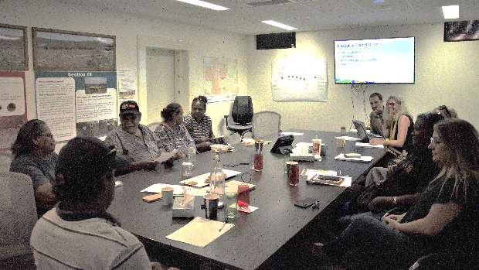
Case study: YMAC-RRKAC return
AIATSIS held 2-day workshops with YMAC (May 2019) and RRKAC (October 2019) including interviews
YMAC Return of Material (RoM) policy and process evolved since 2013 for 2 types of returns: common law holder, personal
YMAC-RRKAC return discussions started in 2018
RRKC returns process: establish advisory committee, consultation (3 workshops), policy developed and ratified
Workshop with the RRKAC Heritage Advisory Committee and staff.
Notes:
The first case study of the RNTM project was looking at the transfer of material between YMAC and RRKAC.
YMAC developed policies and processes for two types of returns to
Common law holders - where materials related to the whole claim are returned to the native title holders for collective management and access – usually facilitated by a PBC who is nominated as repository
personal returns to an individual or a family, containing their own/family statements and recordings and/or genealogies;
RRKAC and YMAC started talking about returning NT materials in January 2018, even before their second determination in April 2018 after 15 years of research and legal process.
YMAC developed a best practice process. Based on a collaborative approach 3 workshops were held in 2018 where they:
provided information over the process and what materials were returned
RRKAC as PBC was established as the holder of the materials
workshop with family members about family specific information
consultations re personal returns, culturally restricted material
collaborative work on policy document
Benefit of the workshops and developing a policy was for Robe River Kuruma (RRK) People to make the decision about how they wanted their materials managed going into the future. Writing the policy started in October 2018 and took 12 weeks till final draft.

Slide 10
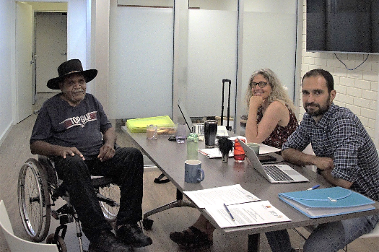
YMAC-RRKAC return continued
delays and road blocks
index and materials were provided to RRKAC in Jan 2020
personal returns are ongoing
cost of return
lessons learned
Working with Robe River Kuruma elder and Heritage Advisory Committee member Neil Finlay.
Notes:
Some frustration about the delays and road blocks
RRKAC needed clarification of the content of materials, found it difficult to navigate this material.
RRKAC respects the confidentiality of individuals, but also had concerns that many of the oral history materials and those of potentially most value to RRK families may not be returned.
some frustration from the community that their independence was not being recognised
shift in community views about the long-term use of the materials. RRK people acknowledged and embraced the significant importance of the material being held collectively. There was a need to amend the policy regarding return of family information. The community shared a desire to see all of the materials held by RRKAC for storage and safekeeping – like a bank. This meant a requirement from YMAC to go back to the community to amend the resolution and ratify in a common law holder meeting
availability to meet and resourcing also delayed progress.
YMAC acknowledged that PBCs are conducting ongoing consultation with native title holders and NTRBs need to trust these consultations. They also need to ‘let go’ as the ongoing management of information after the return is up to the PBC.
YMAC staff time: approx. 123 days across three staff members, with one staff member making up the bulk of it (88 days).
At YMAC’s current anthropologist daily rate, the ‘time’ adds up to $153, 750. + cost for travel and workshops/meetings.
Lessons learned are extensively provided in the YMAC - RRKAC AIATSIS Summit presentation:
returns are hard and complex processes
its a lot about managing expectations
stay open-minded and keep talking about it to everyone
resourcing and finding the right time is difficult for NTRBs and PBCs

Slide 11
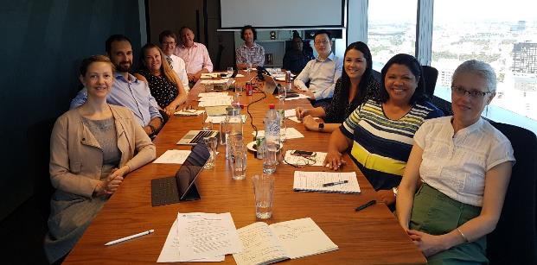
A digital approach with ETNTAC
AIATSIS part of co-design meeting Nov 2019, interviews, emails
request for material returned from GLSC started in 2014
Grant Thornton (administrator) facilitated a digital approach, established retrieval process
ETNTAC established access policy
digital process finished 30 June 2020
ETNTAC required IT and access management capacity before handover
funding has come through Aug 2021
Attendees at the Perth co-design meeting represented ETNTAC, GLSC, NTSG, Grant Thornton and AIATSIS.
Notes:
ETNTAC requested their material back from Goldfields Land and Sea Council since their determination in 2014. GLSC couldn't respond to the request due to the usual constraints: funding, resources, capacity. After GLSC was defunded on 30 June 2019, and Grant Thornton was appointed administrator, the mater became urgent.
At the time GLSC held more than 900 archive boxes and 3.5 mio digital files that needed to be rehoused. Of these 91 were clearly labelled ETNTAC which contained folders with additional information on their content (very rudimentary index). Of the millions of files 50 000 digital files could be identified by using automated indexing software with the key search term ‘Esperance Nyungar’. Of these 50 000 files 20 000 were unreadable (either password protected or corrupted). All material except the ETNTAC material was removed to Iron Mountain in Perth, a secure climate controlled storage facility.
AIATSIS was asked by National Indigenous Australian Agency (NIAA) to take part in the Nov 2019 co-design meeting where representatives from ETNTAC, Grant Thornton, a former GLSC anthropologist, the new Native Title Services Goldfields CEO and the native title branch manager NIAA worked out the process for return.
Grant Thornton suggested a digital approach using digital forensic analysis software:
Hardcopy files were scanned and OCRd,
digital files form server and cloud storage were consolidated,
Data cleansing, duplicates consolidated into single file
all ingested into NUIX database
PBC provided a list of keywords relevant to their circumstances (personal & family names, place names, language names, misspellings)
Established retrieval process
GT received a request from ETNTAC
Administrator searched database
Administrator Located , identified, if necessary scanned & processed the documents
Administrator considered cultural, legal and privilege protocols, if necessary consulted with GLSC
ETNTAC is provided the document
While the digital process of scanning and ingesting was finalised by 30 June 2020 ETNTAC still hasn’t gotten its material returned. Administrator requested ICT requirements including secure storage, sufficient server capacity and a staff member who can manage the material before the NUIX database could be handed over.
ETNTAC was seeking funding and received it by August 2021 but is still implementing the requirements. If they wanted material they still needed to ask GT for access.
They biggest issue is though that without an inventory or index they simply don’t know what is contained and what they can and should ask for.
Lessons learned:
forensic approach is affordable and provides a workable solution for PBCs, but not infallible (sometimes documents can’t be found)
Inventory or index is essential
funding is difficult to obtain and inequitable in distrirbution

Slide 12
Aboriginal land rights in the Northern Territory: Documenting and preserving the records and memories
survey of land claim practitioners, 17 Dec 2020 – 1 Feb 2021
Notes:
Coming to the last case study about materials held from Northern Territory land claims.
While the materials produced as evidence in the land claim determinations might be held as Commonwealth records by the National Archives of Australia and also the NTRB/SPs, many of the research materials supporting the claims did not make it into evidence. They are the ‘backstory’ of the claims sitting in land claim practitioners private archives. Not all of these materials are held by NTRBs and I suspect this is also the case for native title materials.
Survey details
survey with 54 respondents known holding archives
Survey results
5 started their land claim work before 1976, 30 from 1976-85, 34 worked from 1986-96 onwards. 82% have materials stored at home and 16% needed to find off site storage
12 archive holders had none of their materials documented, 25% (2), 50% (3), 75% (4), only 5 had all their materials documented
volume of material held is staggering for the physical materials held in archive boxes 1-10 (23), 10-20 (8), 20-50 (6), more than 50 (6)
This is equally the case for the estimated the volume of digital archives 12 none, <10GB (11), 10-50GB (5), 50-100GB (5), 100-200GB (4), 200-500GB (4),5 had more than 500GB
15 made plans for institutional deposits while 30 had no plans
Private archive holders are concerned about their materials, as they are now in their 70s or 80s, and some of them have already passed away leaving archives behind. The families often don’t know what to do with them or understand their significance. But they can’t be deposited or returned before they are documented. And this it’s a daunting task.

Slide 13
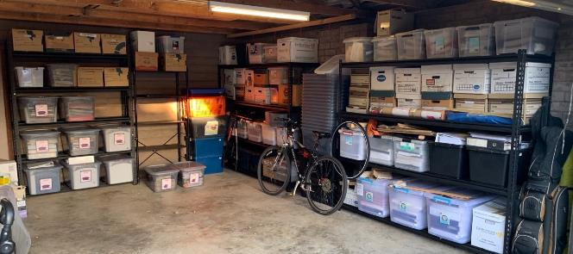
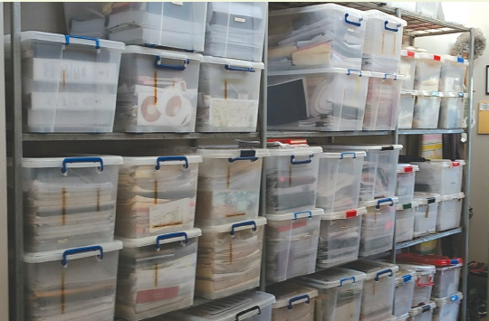
Aboriginal land rights in the Northern Territory: Documenting and preserving the records and memories
aims of case study
focus group meeting
draft First Glance Template
case study Stage 2 underway
Retired lawyer’s archive spanning over 40 years of land and native title claim work located in his garage. Photo: David Parsons.
Office archive of a native title practitioner. Photos: Daniel Vachon
Notes:
Aims of the case study are
secure support to ensure the safety, preservation and documentation of those ‘back story’ materials
encourage practitioners to begin preparing a record of their own materials.
finding funding or archiving volunteers to assist with documentation
work towards new approaches to cataloguing, digitising and managing returns to enable and facilitate appropriate access
record practitioners memories as they make these archives so much richer.
In stage 1 we conducted a focus group meeting in 2019 discussing challenges and issues with private archives and plans how this project should progress. Then Covid hit and the planned work of pilot studies going into peoples archives and documenting them wasn’t possible.
Instead we wrote a draft First glance template, a tool to start documenting your collection. It’s a draft as it is at the moment concentrating on hard copy files but we want to refine the documentation of digital archives in Stage 2.
Stage 2 has just started and we are planning on conduction 1 pilot study, the Kenbi Larrakia land claim, where we document the archives of practitioners holding relevant materials.

Slide 14
Challenges
Ownership
Copyright, IP and ICIP
Storage, collection management and preservation
Access, privacy, confidentiality and privilege
Resourcing
Notes:
As we established earlier the materials were amassed during native title or land claims with the purpose and focus on supporting the claim and legal proceedings.
To find retrospective solutions to return native title materials to traditional owners provides a number of challenges. We have grouped them under five key categories:

Slide 15
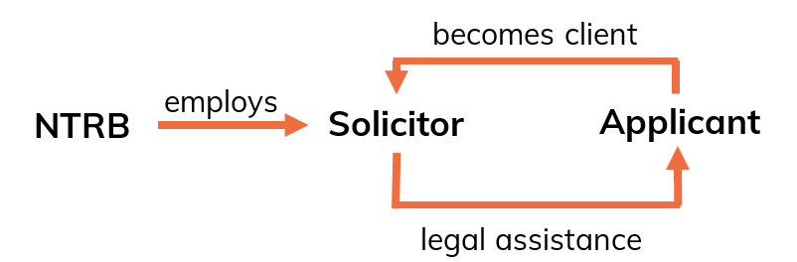
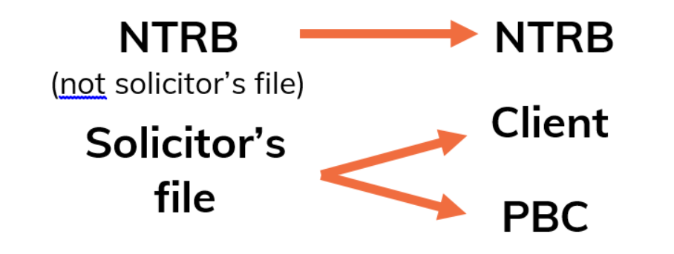
Ownership
NTRB commissions research as part of its functions
solicitor holds files
cultural ownership
sometimes need to seek legal advice retrospectively
Notes:
Who owns the materials assembles during native title claim research? (Angus Frith presented on this topic during the AIATSIS Summit 2021 and his presentation is available online)
Under the NTA s203BB NTRBs have the function to facilitate and assist with:
researching and preparing native title applications, and
assisting persons who may hold native title (including by representing them or facilitating their representation) in proceedings relating to native title determination applications to the Federal Court; future acts; etc.
Not all NTRBs can conduct all the research themselves but they can commission research as part of their function. For native title claims the research materials are held by the NTRB or by an NTRB employed solicitor as part of a solicitor’s file established in working for a native title applicant, which technically is in the possession of the solicitor (not the NTRB).
NTRB may perform its facilitation and assistance function when it provides the services of one of its employed solicitors to a native title applicant.
the solicitor then provides legal assistance to the applicant in relation to the native title determination application
a solicitor/client relationship is established and the applicant becomes the client of the solicitor
in that capacity, the solicitor commissions the preparation of the research material, which is held in the solicitor’s file in the NTRB’s office
In general terms:
most documents on a solicitor’s file are owned by the client (= the applicant), e.g. research materials
some documents on the file are owned by the solicitor, e.g. records of money held on trust for the client
some documents are owned jointly by the client and the solicitor, e.g. solicitor’s notes of conversations with other parties
Some documents are subject to an additional obligation of confidentiality regarding sensitive family information or restricted cultural information
Once the native title determination application is finalised:
research material held by the NTRB/SP that is not on a solicitor’s file belongs to them, arguably on trust for the benefit of the native title holders
most of the documents on the solicitor’s file are not owned by the solicitor or by the NTRB, but by the solicitor’s client (= the native title applicant)
certain rights in relation to the documents in the solicitor’s file pass to the PBC on the determination of native title [see Tommy [83]]
The NTRB solicitor must obey the client’s instructions, about what is to be done with the originals of client owned documents.
Depending on the instructions of the applicant/PBC, the documents could be:
given to the PBC, to be held on behalf of the native title holders, to be used to manage and protect native title
retained by the NTRB, potentially to be used for the ongoing benefit of the PBC, like additional claims or compensation claims
destroyed
Cultural ownership of materials can be difficult to identify as materials were created, stored or shared across organisations and parties involved in the native title process. The circumstances of collections can vary as they could have been collected in the contexts of disputes over boundaries or group membership. They are often collated at a regional level to assist in determining the basis for applications to be lodged.
But what about the IP of materials?

Slide 16
IP, copyright and ICIP
IP can be held by NTRB, applicant, researcher
Copyright laws apply to native title materials
Copyright held by photographer, recordist, camera man, author or collecting institution
Historic photos, orphan works
Notes:
Intellectual property and copyright also present a challenge.
From an IP perspective rights to the materials can be owned by: the NTRBs, who commissioned the work, the applicants/ TOs, who provided the information, and the researchers, who authored the reports.
Under copyright law the photographer, recordist, camera man and author hold copyright to the materials they produced and does not acknowledge the knowledge or story contained in these products. The Indigenous cultural and intellectual property (ICIP) belongs to the individual or community who provided the information or is captured by the recordings, photos and writings. This aspect was never considered or documented during collection of native title materials.
Institutions from which research materials were obtained may also hold copyright over these materials like South Australian Museum for Tindale, or Sydney University for Stanner materials.
Research materials were often obtained under conditions not to copy, distribute or use for anything other than native title proceedings. These materials cannot be passed on to a PBC.
Consultants contracted by NTRBs may have obligations and rights stated within their contracts. But we found that particularly with materials produced 40 years ago their status is murky, for a lack of contractual arrangements about ownership and retention of materials. Archive holders have a range of photos taken in the context of the claim work but they are poorly documented. If they return such photos do they need to ask each photographer if they can do so? What if the photographer can’t be determined or isn’t contactable. In this case such material can be declared as an orphan work but there is a reasonable effort involved and is this effort required for each such photo?
As part of Stage 2 of the land claim case study we are seeking more guidance in this matter and hope to be able to produce guidelines for all the various classes of documents typically found in such land claim/native title archives.

Slide 17
Collection management, storage and preservation
no documentation – no return
storage capacity, hardcopy vs digital files
need to digitise before 2025
digital preservation
future of hard copies
Notes:
Collection management is a great challenge for native title materials. Without indexing or some form of documentation of the collection a return is not possible. This is the case for NTRB/SPs and private archive holders.
For PBCs not knowing what is in the collection makes it difficult for them to determine what they want back and how they want it returned.
Most NTRBs, PBC and practitioners have difficulties with storage of native title materials. If they are hard copy files the sheer amount is daunting. Most PBCs are not equipped to hold, manage or provide a secure future for physical files, for which reason most returns are digital copies. For private archive holders the challenge is in what to do with their holdings and how they can be deposited or returned.
The need to digitise at risk materials has been discussed earlier but 2025 is a real thread and requires action before material is irretrievably lost. All digital files require good metadata to enable management, discoverability and access. We have published two simple guides on metadata.
For digital files the challenge for PBCs in particular lies in the ICT capacity (the equipment, storage capacity and expertise) to even house the files. More pressing is, what to do with the files once they are delivered on an external hard drive. How can they be managed and made accessible to their own needs and the needs of the community. There are various database systems available but how to choose what is most suitable and affordable and how to finance the implementation, subscription fees and long-term support?
How can the digital files be preserved? They need to be migrated into the newer technological formats to stay accessible into the future. This is a huge burden for NTRBs and PBCs.
What should happen with the hard copy materials? Should they stay with the NTRB/SP? Can they be destroyed once a good digital copy exists? These issues are yet unresolved. This is not only the case in the native title sector but all national collection institutions in Australia and oversees are grappling with the same problems.

Slide 18
Access and privacy, confidentiality and privilege
access dispersed across NTRBs, the Court, private archives and public collecting institutions
all parties must ensure that a transfer of materials does not effect:
obligations of confidentiality, privacy, privilege, intellectual property etc
restrictions imposed by the Court or by the group’s own traditional laws and customs
access protocols/policies need to be established that maintain these obligations
Notes:
Access to NT materials for native title holders is difficult because they are dispersed across holdings by NTRBs, the Court, private archives and public collecting institutions. The ultimate aim should be the recognition of the rights of First Nations communities to control their knowledge, culture and stories which includes sovereignty over their data.
Privacy, confidentiality and legal privilege issues arise for all parties involved. They need to be addressed before selecting and passing on materials. A transfer of research materials should not affect existing:
obligations of confidentiality, privacy, privilege, intellectual property etc.
restrictions imposed by the court or by the group’s own traditional laws and customs
Materials can only be transferred once access protocols have been established that maintain the restrictions and conditions attached to the materials.

Slide 19
Resourcing
NTRB/SPs
ongoing collection management & storage
capacity to audit / digitise before 2025
capacity to index / document in prep for return
conduct returns process / workshops / travel / consultation
PBC
capacity for storage / management of materials
provide adequate access though staff, training and database
Notes:
Resourcing the return of native title materials to traditional owners requires funding for NTRB/SPs to enable:
the ongoing collection management & storage
the capacity to audit and then digitise materials before 2025
indexing and documenting in preparation for returns
conducting returns process / workshops / travel / consultation
All these resourcing issues also apply to private archive holders. They might be at a different scale but are still prevalent. While PBCs can apply for capacity building funding from NIAA, private archive holder’s avenues to seek funding for such activities are very limited.
Funding for PBC is required to enable:
the capacity for storage / management of materials
provide secure and safe access to materials by employing staff with adequate training and the use of databases or data management systems

Slide 20
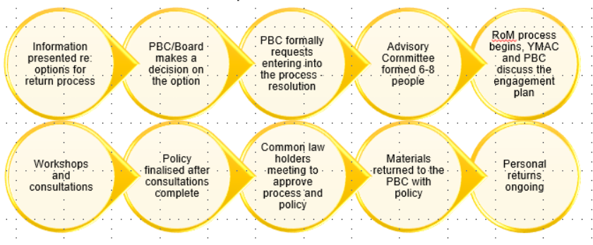
RNTM conclusions
native title holders need access
best practice: principles and processes for return of native title materials
legal reform
prioritise digitisation and preservation
funding requirements
Returns process established by YMAC.
Notes:
In wrapping up the project established that research materials gathered during native title claims are important for native title holders as recordings of their country, kinship, language, laws, lore and histories. They are the contemporary embodiment of connection to country and society and native title holders need access to these materials. It is not good enough to declare it a business decision for native title holders if and how they can self-manage these materials on their country but it should be the default.
As Josie Alec, a Robe River Kuruma native title holder expressed it:
‘This is my family. It doesn’t belong to the government, it doesn’t belong to anybody… [other than us]. That sort of dialogue needs to change.... I’m not this poor black person over here that you need to go and hold stuff for, no. No, I’m the maker of my own destiny. And so are my children.’
All efforts need to be made to return materials which requires safe and accessible infrastructure and human resources to achieve long-term and sustainable solutions. Furthermore, considerations should be made how the self-management of these materials can be incorporated in current and future native title research.
A set of principles for all returns was established by Angus Frith during his presentation at the AIATSIS Summit 21:
to recognise their native title rights NT (Common Law) holders should control the storage, use and access to NT research materials
NT holders need to agree to transfer of NT materials from NTRB to PBC
existing obligations (confidentiality, privacy, privilege IP, ICIP etc.) and restrictions (imposed by court or determined by traditional law and customs) should not be affected by a transfer of materials
to enable the PBC to maintain such obligations and restrictions the NTRB should identify them
NTRB/SP and PBC should both be obliged to ensure the PBC has adequate storage facilities and the capacity to properly manage the storage, use of and access to the research materials in accordance with the requirements of the native title holders
consider if the NTRB should retain copies/originals, and if so, the appropriate conditions for its storage, management and use of these materials
NTRB/SP and PBC should agree:
purposes for which
persons by whom
conditions in accordance with which
the research material held by NTRB/SP and/or PBC will be accessed, used or disclosed
Three Models of return with varying involvement of the NTRB and a workable process was established by YMAC. This process is to be reviewed and collated in a best practice document, published on the RNTM website.
Legal reform is required to acknowledge Indigenous Cultural Intellectual Property (ICIP) rights, the communal ownership of Indigenous knowledge's contained in NT materials versus the individual ownership of intellectual property (IP). That is to say, Indigenous data, information and creations should be automatically protected under any new legislative scheme.
To provide equitable access to the invaluable materials resourcing is needed as discussed earlier. To ensure the safety of the most vulnerable materials on magnetic tape carriers urgent action is needed to identify and digitised them by 2025.

Slide 21
The RNTM publications and outlook
https://aiatsis.gov.au/research/current-projects/returning-native-title-materials
Resources
a number of reports and presentations available online
draft First Glance template
metadata guides
Outstanding
RNTM project report
template agreement
transfer best practice guide
land claim project Stage 2: more practical resources to be developed
Notes:
You’ll find all published reports, resources and presentations on our website with further links to the case studies.
Resources available are
the individual reports of the case studies,
the Native Title Conference presentations
the first glance template
resources such as metadata guides and all publications yet to come
We are working on:
a template agreement
a best practice guide including principles and process
the overall RNBTM report
more practical resources to be developed during land claim project Stage 2

Slide 22
Thank you
The Australian Institute of Aboriginal and Torres Strait Islander Studies acknowledges the traditional owners of country throughout Australia and their continuing connection to land, culture and community. We pay our respects to elders past and present.
aiatsis.gov.au
Notes:
In the foreword for the book on central Australian Archival returns David Ross AM, a previous CLC Director, highlighted that it is important to honour the struggle that Traditional Owners, many of whom are now deceased, have endured.
What stands out about the men and women who fought for these rights is their unwavering commitment to land, language, and culture, in the face of generations of brutalising control over people’s lives and the related domination of traditional lands.
It is also part of the process of reconciliation and healing as expressed by Robe River Kuruma native title holder Sally Atkinson:
‘It’s really important. I think it’s also like closure in a way, like it’s a circle. The process started however long ago, going through native title, and all the family losses and community losses, and people that have gone through that and haven’t been able to see the day that native title was handed back, and then the return of the research materials and information, I think is going to be quite significant, and some closure for some people.’
Thank you

